Slide 1

Ogden v Gibbons
Eduardo Quiame
HIS231-05

Slide 2

Gibbsons Partnership with Aaron Ogden
power to regulate interstate entailed the power to regulate navigation
Thomas Gibbons a partnership with Aaron Ogden, collapsed when Gibbons started to operate another steamboat on a New York route
A caused to stop Gibbson ruled in his favor since only Congress can regulate interstate commerce

Slide 3
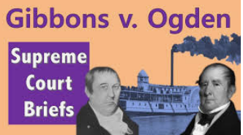
Significance of Supreme Court Decision
Regulation of steamboat operators for the purpose of interstate commerce was a power reserved by the Congress
It allowed merchants to trade freely between different states
It allowed consumers and producers to buy and sell products under uniform rules

Slide 4
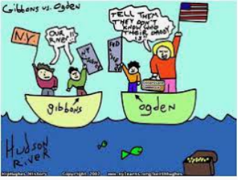
Impacts of Supreme Court Decision
It served as a precedent of similar cases later
It impacted trading activities among different states
States could not interfere with the power of Congress to regulate commerce
Trading activities was made uniform among the residents of the different states

Slide 5
References
References
Abel, A. S. (1946). Commerce Regulation before Gibbons v. Ogden: Interstate Transportation Enterprise. Miss. LJ, 18, 335.
Baxter, M. G., GibbonS, T., & Ogden, A. (1972). The Steamboat Monopoly. Gittons V. Ogden, 1824. Alfred A. Knopf.
Johnson, H. A. (2010). Gibbons v. Ogden: John Marshall, steamboats, and the commerce clause. Univ Pr of Kansas.
Marshall, J. (1824). Gibbons v. Ogden. Joseph P. Cotton, Jr.[éd.], The Constitutional Decisions of John Marshall, 36-83.
Schoeppner, M. (2009). Legitimating Quarantine: Moral Contagions, the Commerce Clause, and the Limits of Gibbons v. Ogden. JS Legal Hist., 17, 81.
Websites
https://www.britannica.com/event/Gibbons-v-Ogden
https://www.oyez.org/cases/1789-1850/22us1
https://www.thirteen.org/wnet/supremecourt/antebellum/landmark_gibbons.html

